Slide 1
Lake Worth’s Oldest Houses
Historical Society of Lake Worth
Preservation Paper #1
By Marion Cone

Slide 2
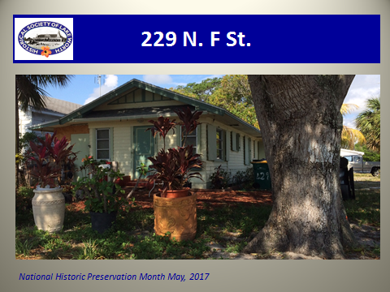
Oldest Houses #1
229 North F Street
Owned by Thomas E. Greer, Jr. who was a carpenter. It is a frame house built on Block 60 / Lot 18.

Slide 3
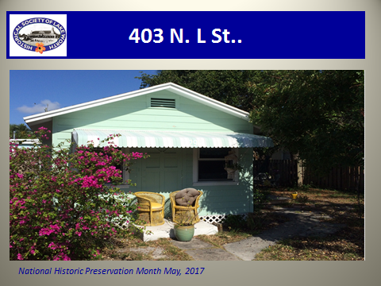
Oldest House #2
403 North L Street
Owned by L. G. Welton, a clerk. It is a frame house built on Block 112/ Lot 21.

Slide 4
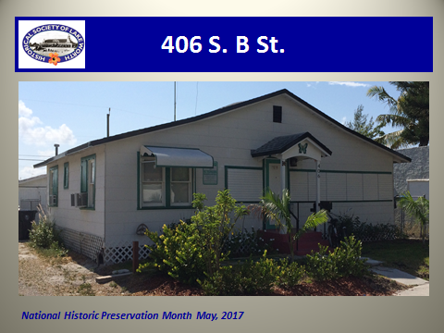
Oldest House #3
406 South B Street
Owned by E. D. Cramer, a farmer. It is a frame house built on Block 137/ Lot 6.

Slide 5
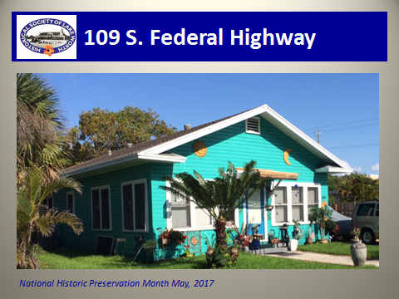
Oldest House #4
109 South Federal Highway
Owned by Mrs. Post and was a rooming house. It is a frame house built on Block 43/ Lot 11.

Slide 6
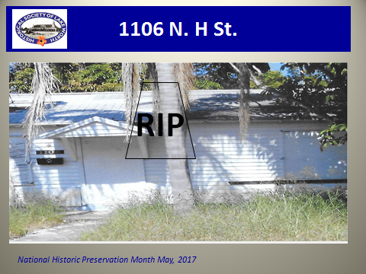
Oldest House #5
1106 North H Street
Owned by John Klots, a contractor-builder. It is a frame house build on Block 342/ Lot 2. Unfortunately it is beyond repair and will be torn down.

Slide 7
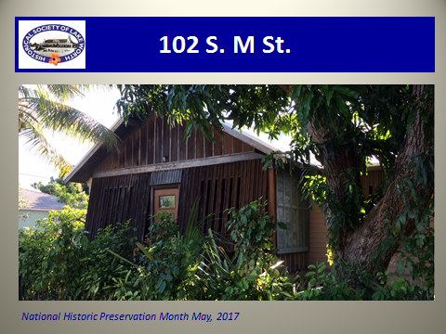
Oldest House #6
102 South M Street
Owned by James M. Love and Theressa. He was a contractor and was elected the first Mayor of Lake Worth in 1914. It is a frame house built on Block 43/ Lot 8.

Slide 8
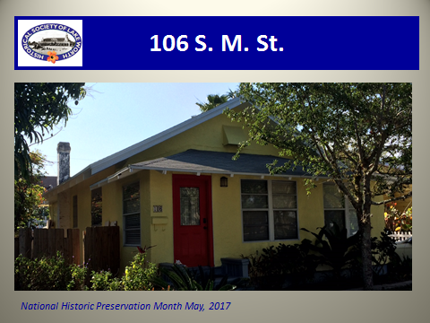
Oldest House #7
106 South M Street
Owned by Leon S. McGill and Miss Audrey. He was a carpenter and she was a bookkeeper. It is a frame house built on Block 43/ Lot 7. At the time of the census only the windows were unfinished.

